Slide 1
NCCCIP School Resource Officer Training NCDPI Staff

Slide 2
General System Info
Web based system
Required Software
Web browser (Google Chrome or Firefox recommended)
Works Edge and Safari, IE not recommended
Adobe Reader (Print files open as PDFs)

Slide 3
Accessing the System
Production Site
https://ccip.schools.nc.gov
Log in with NCID Portal

Slide 4
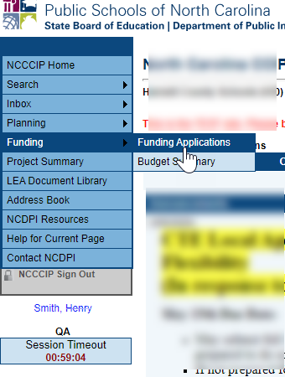
Navigation Menu and Tips
Left menu for quick navigation between NCCCIP components
Hover over menu items with arrows to view sub menu
Demo and Production sites identified below menu
Session Clock. 60-minute session between saves.
Use NCCCIP navigation links; not your browser’s Back button!

Slide 5
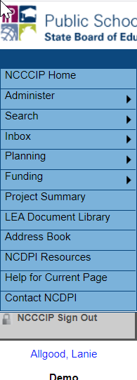
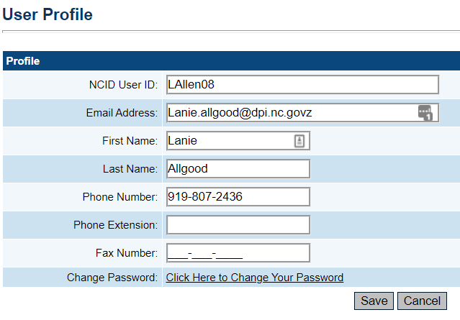
How to Change Your Profile
Log in and click on your name below the menu
Change your email address, name, phone number

Slide 6
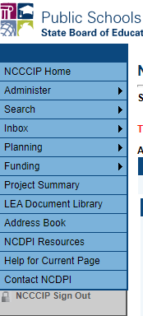
Navigation Menu
Administer – only seen by SEA Administrators and User Access Administrators
Search- LEAs can search other organizations, SEA users have additional options
Inbox – Record of system emails
Funding – Access to all grant applications
Address Book – list of users with LEA and SEA roles
NCDPI Resources– Library of training, program guidance, forms
Contact NCDPI– Submit Feedback form

Slide 7
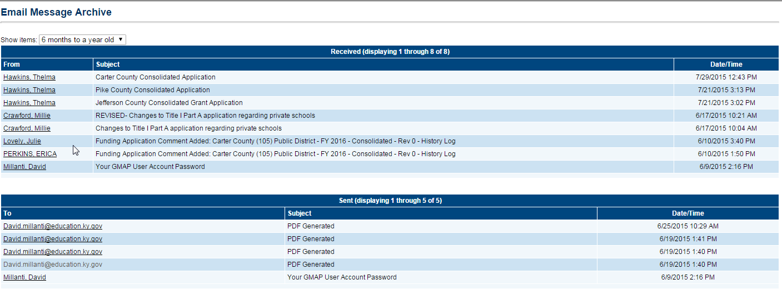
Inbox
System emails are delivered through the regular email system - Outlook, etc
Inbox is a record of all emails created by you or sent to you from CCIP
Use drop down menu to set time period

Slide 8
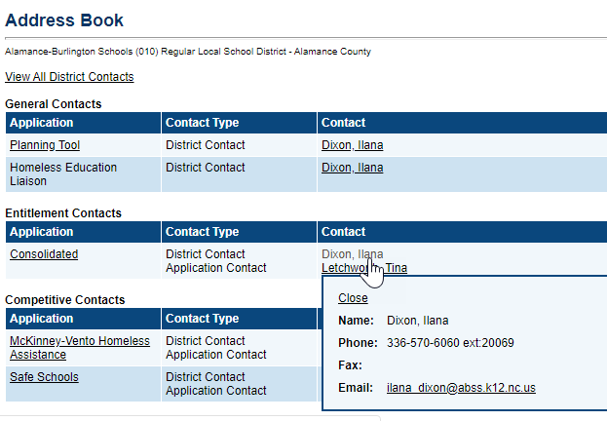
Address Book
Identifies LEA and SEA roles and contacts
Can send an email or access phone numbers
Useful for both the LEA and SEA
8

Slide 9
School Resource Officer Roles and Permissions
Role | Permissions
LEA Safe Schools Data Entry | Moves to Draft Started Creates Application Moves to Draft Completed
Fiscal Representative | Approves or Returns Application
Chief Administrator | Approves or Returns Application
NCDPI Safe School Program Administrator | Moves to Returned to LEA for Edits, if needed and Reviewed Approved for Funding or Reviewed Not Approved for Funding

Slide 10
Roles
A person can have more than one role
More than one person can have the same role
To add or modify roles, contact the district’s User Access Administrator (name is in Address Book)
Notes:
Discuss district roles for 611 and 619 will both have the same roles
May need some coordination before moving to Draft Completed

Slide 11
Page Locking
Multiple people can work in an application at the same time, but only one person at a time can edit a page
Person who accesses page first will “lock” the page while he/ she remains on it
Other users will see message indicating the user that is locking the page
Lock released after that user leaves the page or the session times out

Slide 12
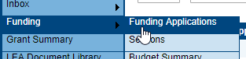
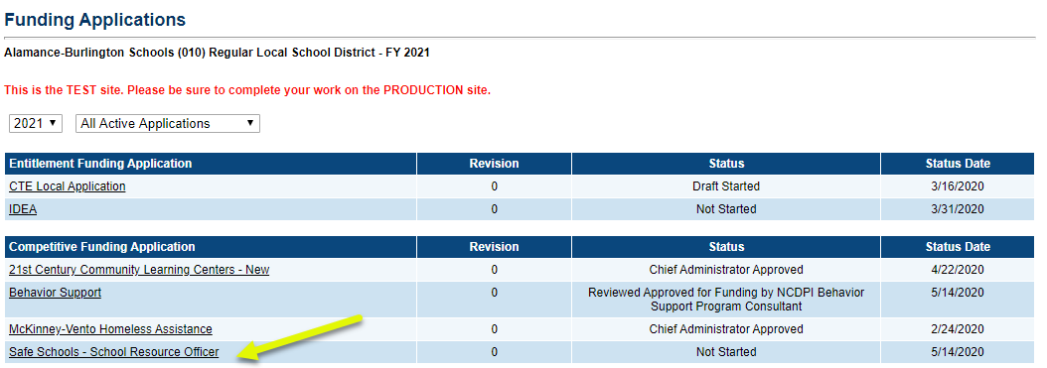
Funding Applications Main Page
Access to all the district’s Funding Applications
Use drop-down filters to find previous years or previously approved applications

Slide 13
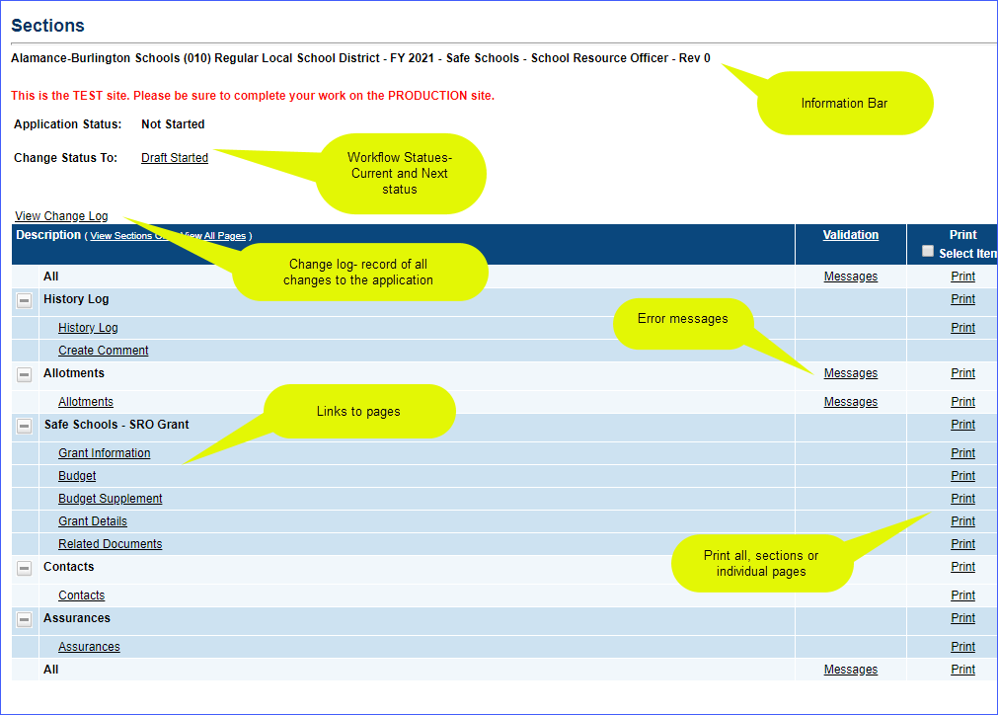
Sections Page
All funding applications have a Sections page
Functions - change statuses, links to grant pages, print, find errors, access Change Log

Slide 14
Begin by Changing Status
Click on Draft Started to start working
Cannot change to Draft Completed without the appropriate role and if Error Messages exist
Current Status- Not Started
Current Status- Draft Started

Slide 15
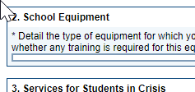
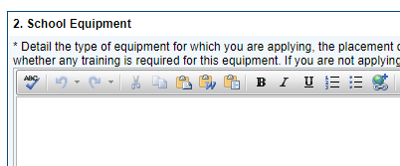
Working in the Application
User must have the correct permission AND
Application must be in Draft Started, Revision Started or one of the Returned statuses.
Other statuses not editable.
DRAFT NOT STARTED
(- cannot edit)
DRAFT STARTED
(- can edit)

Slide 16
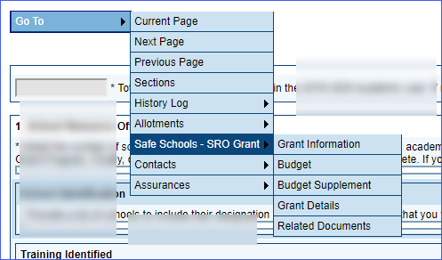
“Save and Go To” Button
Use Go To and Save and Go To button to save your work and move to other pages
Black triangles indicate a submenu
“Go To” button appears on uneditable pages

Slide 17
Save and Go To…continued
Using “Save and Go To” saves any entered data
Data will be lost if Save and Go To button is not used within 60 minutes
Navigate to any other page in the application
Save and Go to Current Page: Saves changes to the page and keeps user on that page
Refreshes 60-minute session clock
15 minute warning before end of session

Slide 18
Messages – Errors/Warnings
System automatically runs validation as application is being edited
Validation issues indicated on the Sections page as Messages
Selecting Messages link displays details
Two types of messages:
Red - Error
Gray - Warning

Slide 19
Messages…continued
Click Review to go to page with validation issue
Errors will prevent status change to Draft Completed
Warnings will not prevent status change

Slide 20
Workflow
Status Move to | What happens
Draft Started | Application open for editing by someone with Safe Schools Data Entry role
Draft Completed | Email to Fiscal Representative Application locked down/no editing
Fiscal Representative Approved OR Returned Not Approved | If Approved, email goes to Chief Administrator Officer If Returned, email goes to Safe Schools Data Entry and it is reopened for editing
Chief Administrator Approved or Returned Not Approved | If Approved email goes to NCDPI Safe School Program Administrator If Returned, email goes to Safe Schools Data Entry and it is reopened for editing
NCDPI Safe School Program Administrator | Moves to Returned to LEA for Edits, if needed, then either Reviewed Approved for Funding or Reviewed Not Approved for Funding

Slide 21
SRO Pages
Grant Information- provides information about the grant and scoring. No fields for data entry
Budget- Enter total amounts requested by Object code
Budget Supplement- enter by categories PLUS local matches
Grant Details- enter data. All fields with an asterisk * are required
Related Documents- Upload Memorandum of Understanding
Contact- Select at least one contact from the drop down list
Assurances- Checkbox for assurance must be selected

Slide 22
Budget
Amount will be negative. If approved, it will have allocation and Remaining will be 0.
Budget Supplement

Slide 23
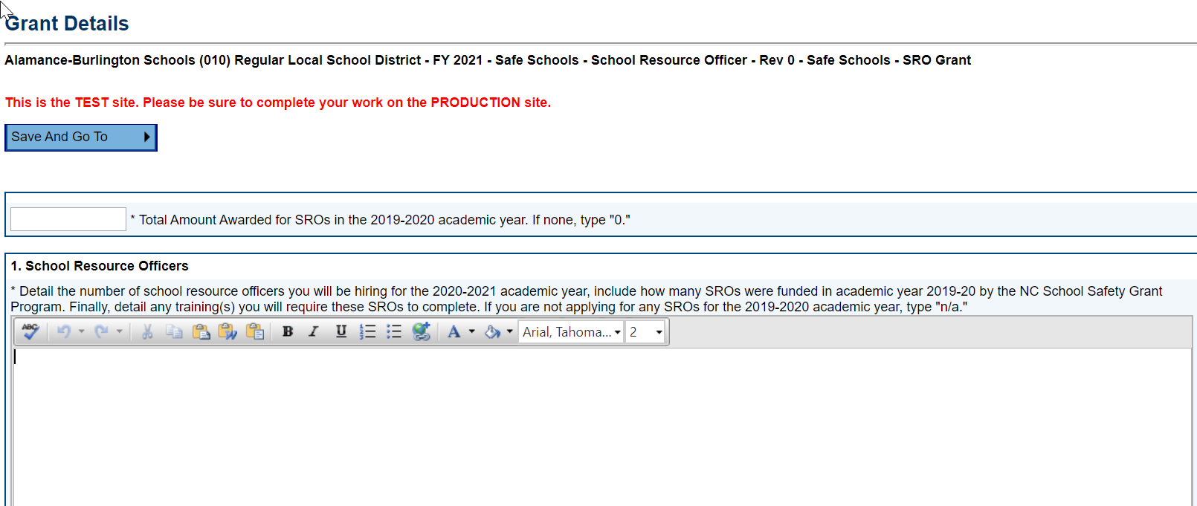
Grant Details
Text Box allows for formatting and unlimited text
Related Documents
Click on Document template if needed to download a template
Click on Upload New to load a document that has been completed and saved to your computer

Slide 24
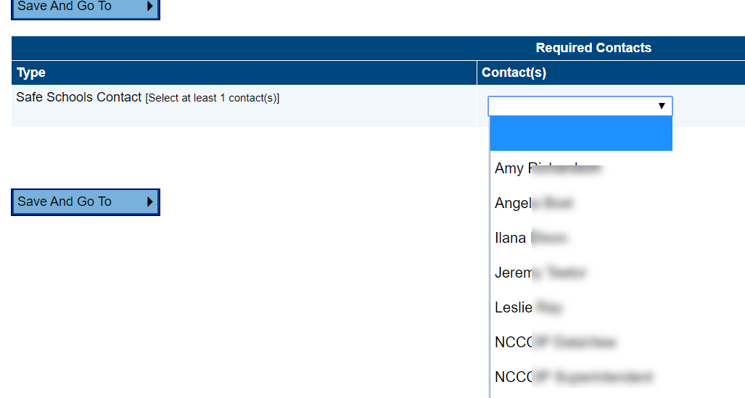
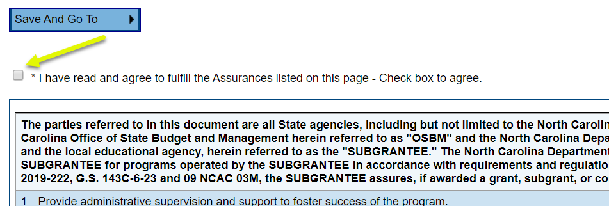
Contact
Assurances

Slide 25
Other Features

Slide 26
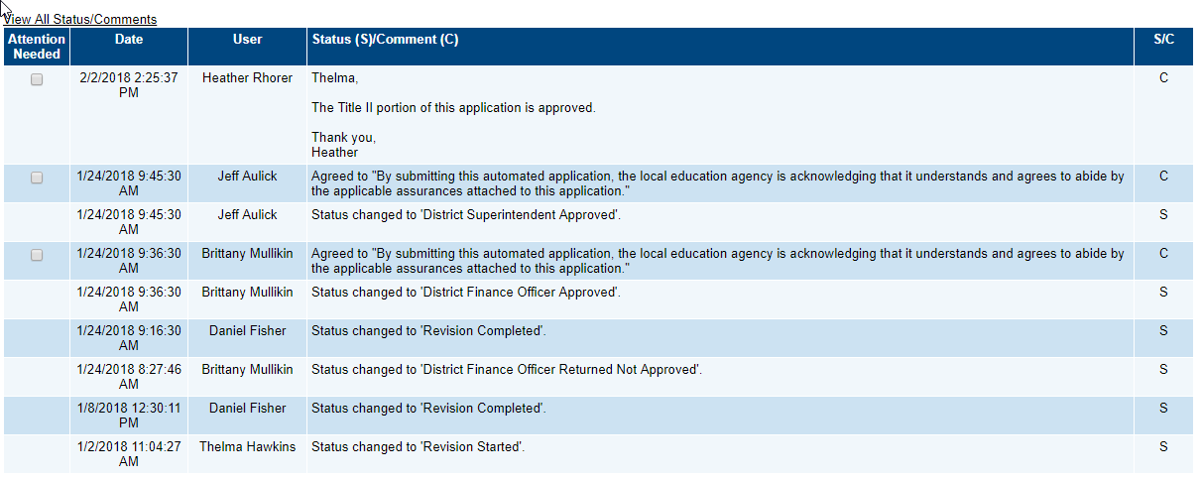
History Log
The History Log displays all status changes and Comments related to a funding application
Includes the User ID and timestamp for the change/comment

Slide 27
Comments
Comments are ongoing notes and discussion between SEA and the LEA related to a funding application
Comments can be made by anyone with access to the application at any time, regardless of status
Can be emailed to intended recipients
Comments are saved with the funding application Not visible to public users

Slide 28
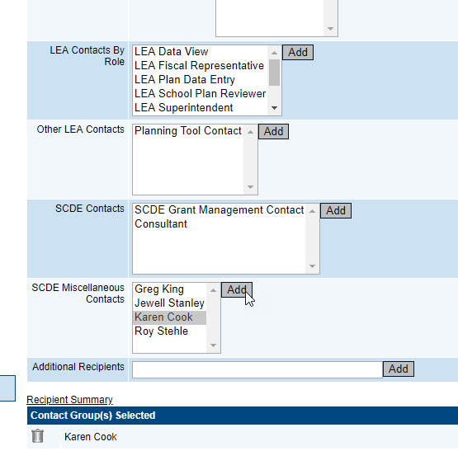
Emailing Comments

Slide 29
Change Log
Identifies all changes to a document occurring after a selected status change.
Allows LEA and SEA users to identify all changes that occur

Slide 30
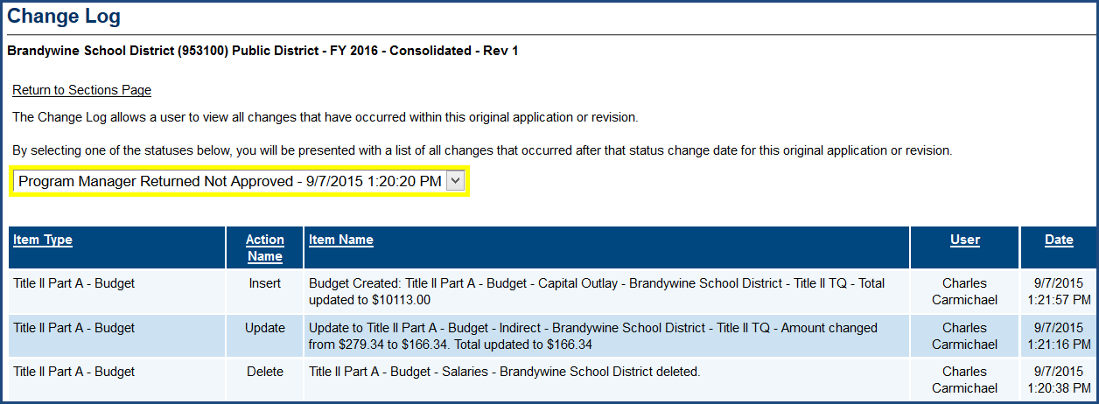
Change Log…continued
Drop down list gives user option of how far back to go in listing changes to the application

Slide 31
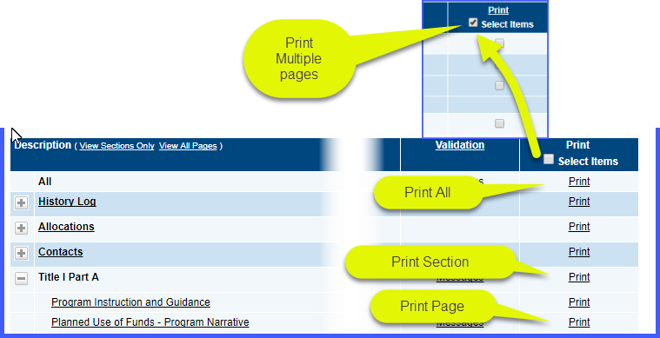
Printing
Print from Sections page
Print created as a PDF
Print Levels: All, single section, single page, or multiple individual pages
Click in Print checkbox to select multiple individual pages
Make sure pop-up blocker is turned off for NCCCIP

Slide 32
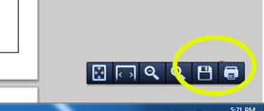
Printing
Small print jobs will be returned and displayed immediately
Larger print jobs (longer than 30 seconds to generate) will send an email when complete
Large print jobs will be available in SCDE Resources for the user
Print job displays as PDF
Print or download from PDF

