Slide 1
NCCCIP Behavior Support Training NCDPI Staff

Slide 2
General System Info
Web based system
Required Software
Web browser (Google Chrome or Firefox recommended)
Works Edge and Safari, IE not recommended
Adobe Reader (Print files open as PDFs)

Slide 3
Accessing the System
Production Site
https://ccip.schools.nc.gov
Log in with NCID Portal

Slide 4
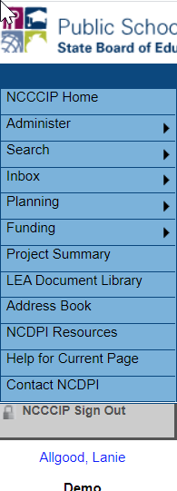
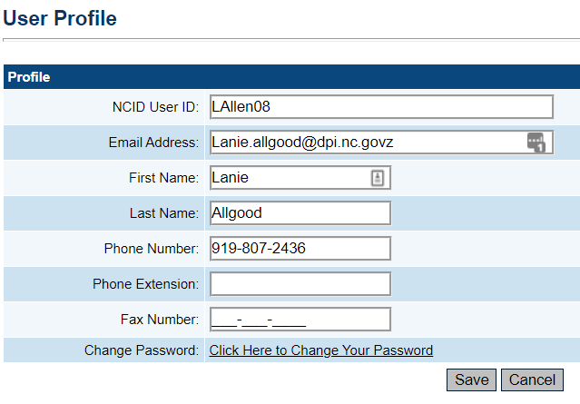
Changing Your Profile
Log in and click on your name below the menu
Change your email address, name, phone number

Slide 5
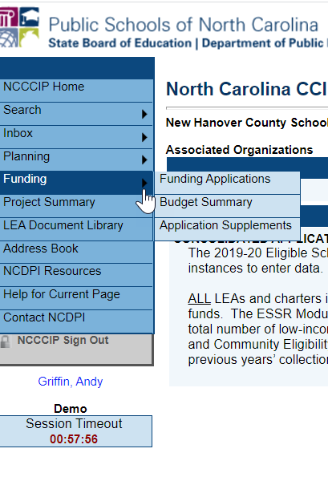
Navigation Menu and Tips
Left menu for quick navigation between NCCCIP components
Hover over menu items with arrows to view sub menu
Demo and Production sites identified below menu
Session Clock. 60 minute session between saves.
Use NCCCIP navigation links; not your browser’s Back button!

Slide 6
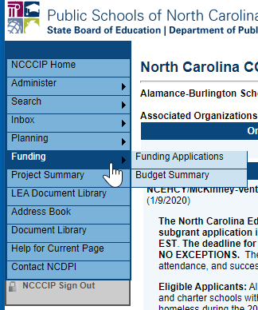
Navigation Menu
Administer – only seen by SEA Administrators and User Access Administrators
Search- LEAs can search other organizations, SEA users have additional options
Inbox – Record of system emails
Funding – Access to all grant applications
Address Book – list of users with LEA and SEA roles
NCDPI Resources– Library of training, program guidance, forms
Contact NCDPI– Submit Feedback form

Slide 7
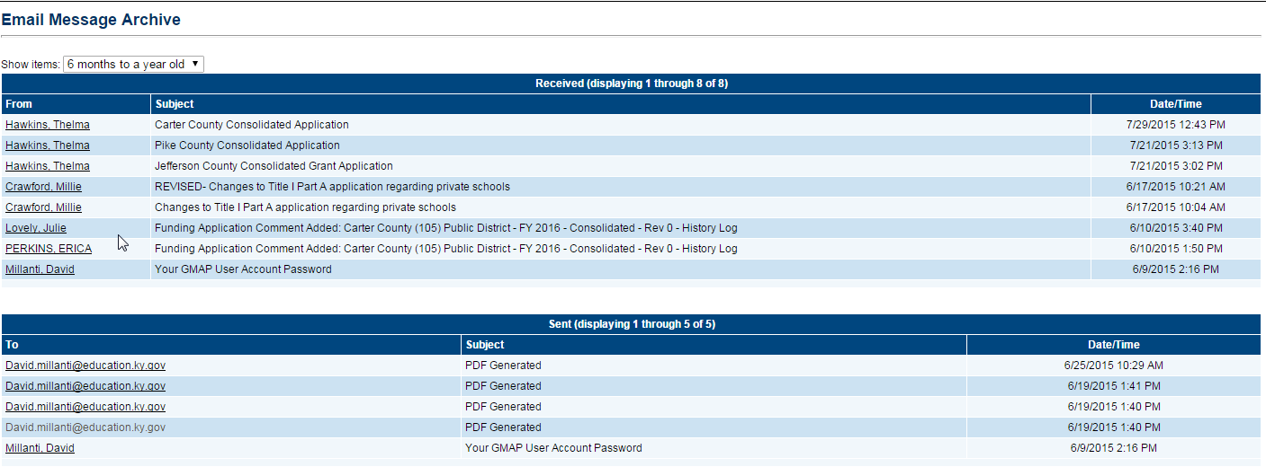
Inbox
System emails are delivered through the regular email system - Outlook, etc
Inbox is a record of all emails generated from the CCIP
Use drop down menu to set time period

Slide 8
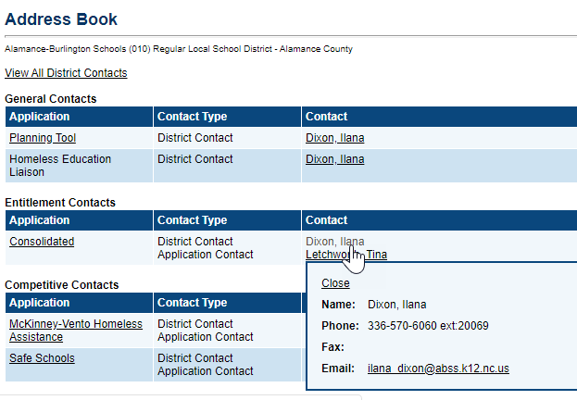
Address Book
Identifies LEA and SEA roles and contacts
Can send an email or access phone numbers
Useful for both the LEA and SEA
8

Slide 9
Behavior Support Roles and Permissions
Role | Permissions
LEA Behavior Support Data Entry | Move to Draft Started Create Application Cannot move to Draft Completed
LEA EC Director | Move to Draft Started Create Application Moves to Draft Completed
NCDPI Behavior Support Program Consultant | Move to NCDPI Behavior Support Program Consultant Returned or Approved

Slide 10
Roles
A person can have more than one role
More than one person can have the same role
To add or modify roles, contact the district’s User Access Administrator (name is in Address Book)
Notes:
Discuss district roles for 611 and 619 will both have the same roles
May need some coordination before moving to Draft Completed

Slide 11
Page Locking
Multiple people can work in an application at the same time, but multiple users cannot edit the same page simultaneously
User will see message indicating the user that is locking the page
Lock released after that user leaves the page or the session times out

Slide 12
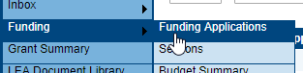
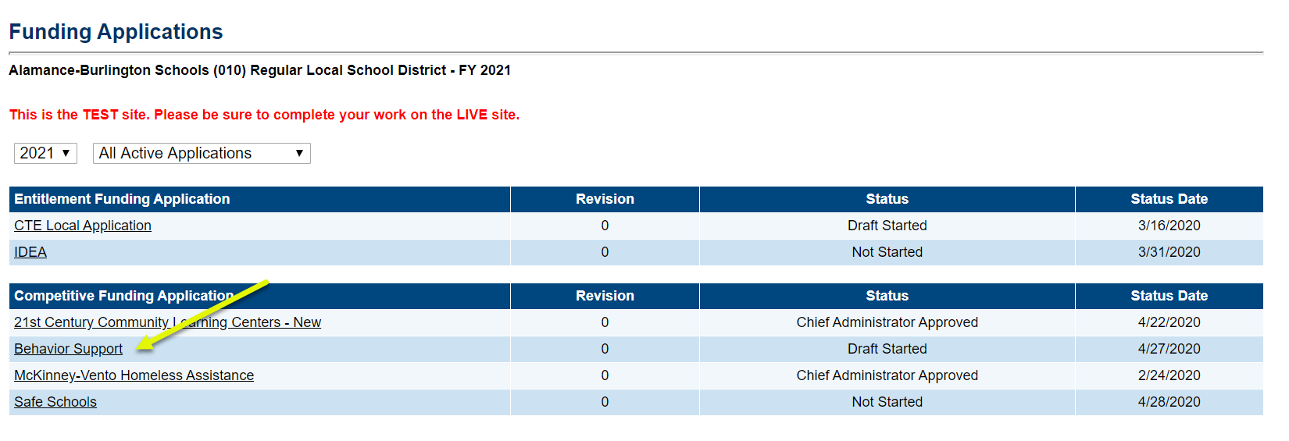
Funding Applications Main Page
Access to all Funding Applications
Use drop-down filters to find previous years or previously approved applications

Slide 13
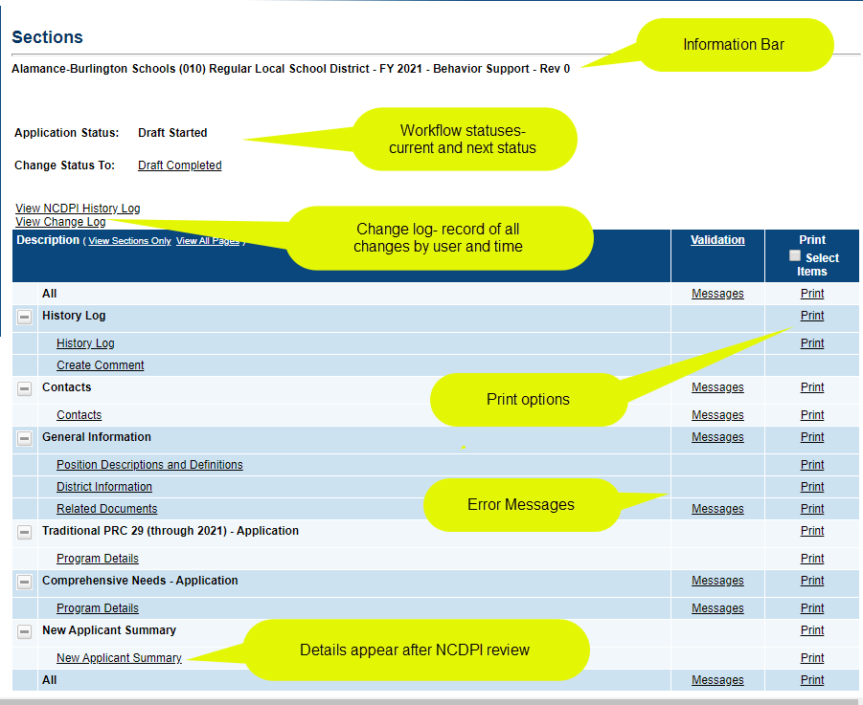
Sections Page
All funding applications have a Sections page
Functions - change statuses, links to grant pages, print, find errors, access Change Log

Slide 14
Begin by Changing Status
Click on Draft Started to start working
Cannot change to Draft Completed without the appropriate role and if Error Messages exist
Current Status- Not Started
Current Status- Draft Started

Slide 15
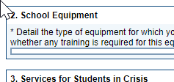
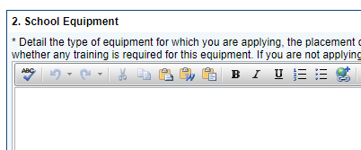
Working in the Application
User must have the correct permission AND
Application must be in Draft Started, Revision Started or one of the Returned statuses.
Other statuses not editable.
DRAFT NOT STARTED
(or not editable)
DRAFT STARTED
(or editable)

Slide 16
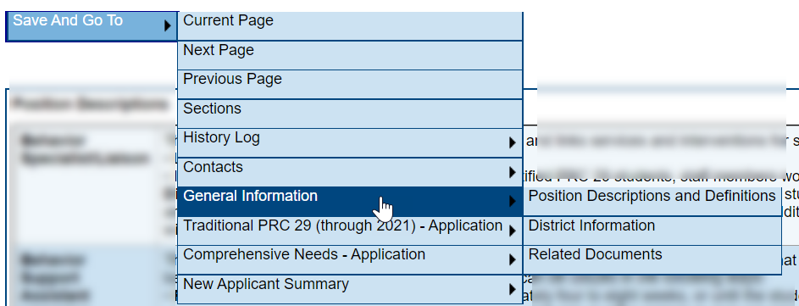
“Save and Go To” Button
Use Go To and Save and Go To button to save your work and move to other pages
Black triangles indicate a submenu

Slide 17
Save and Go To…continued
Using “Save and Go To” saves any entered data
Current Page: Saves changes to the page and keeps user on that page.
“Go To” button appears on uneditable pages
Refreshes 60-minute session clock
Data will be lost if Save and Go To button is not used within 60 minutes
15 minute warning before end of session

Slide 18
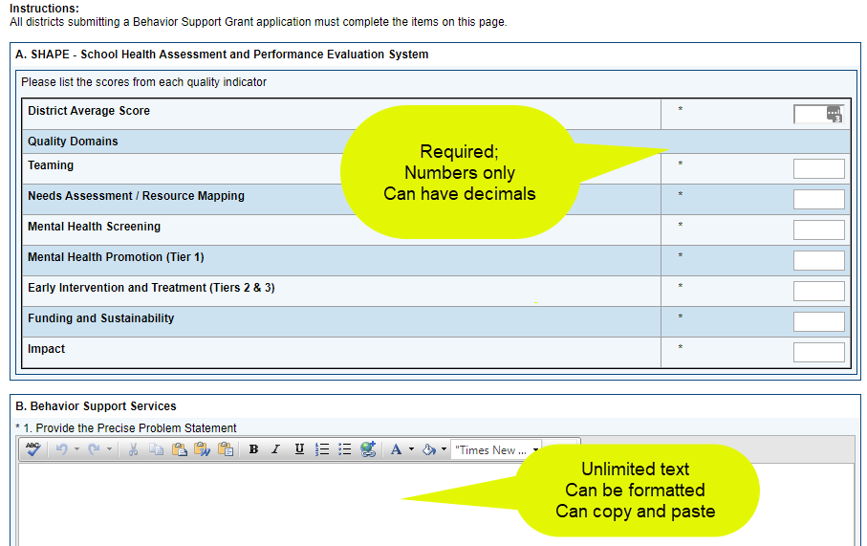
General Information Section
All applicants must complete this section
Position Descriptions and Definitions page is information only
All fields with asterisk are required

Slide 19
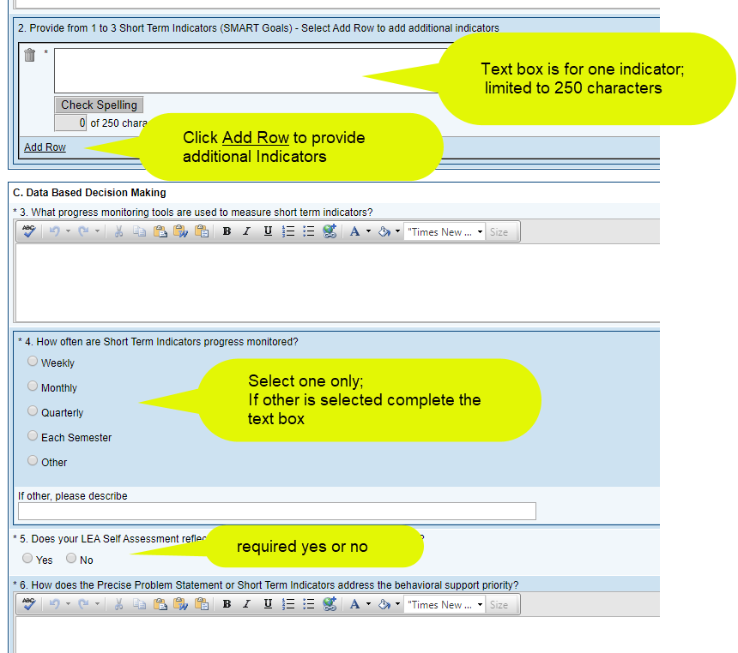
General Information, contd

Slide 20
Program Details
Complete either Traditional or Comprehensive, NOT BOTH
You can enter information for both but you will get an error message and will be doing double work!
Must check box at top of Program Detail page to open it

Slide 21
Budget Information, positions
Use a row for every unique combination of Service Category, % Time and Salary Rate (PRC29) Salary
System will calculate Total Requested Salary and totals for Number and Total Salary Requested
After review and upon approval, NCDPI will load the Salary Allotted

Slide 22
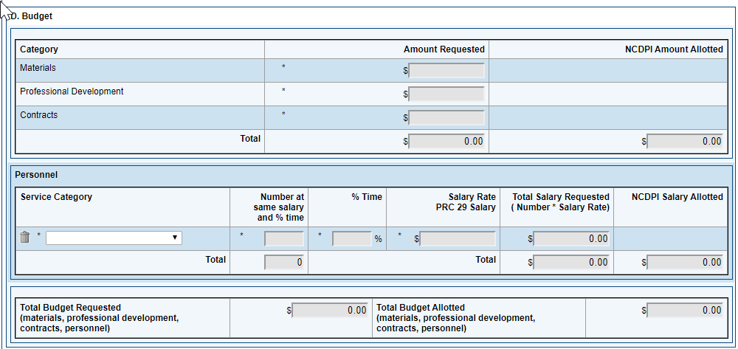
Comprehensive Budget
Enter Amount Requested for Materials, Professional Development and Contracts. If a category amount is not being requested enter 0.
Enter a separate row for each unique combination of service category, % Time, and Salary Rate (PRC 29 Salary)
Approved applications will have allotted amounts loaded by NCDPI.

Slide 23
Messages – Errors/Warnings
System automatically runs validation as application is being edited
Validation issues indicated on the Sections page as Messages
Selecting Messages link displays details
Two types of messages:
Red - Error
Gray - Warning

Slide 24
Messages…continued
Each message is a clickable link
Click Review to go to page with validation issue
Errors will prevent status change to Draft Completed
Warnings will not prevent status change

Slide 25
Workflow
Status Move to | What happens
Draft Started | Application open for editing by LEA Behavior Support Data Entry or LEA EC Director
Draft Completed | Email to NCDPI Behavior Support Program Consultant Application locked down/no editing Must be done to LEA EC Director
Returned to LEA for Edits by NCDPI Behavior Support Program Consultant (if needed) | Email to LEA Behavior Support Data Entry and LEA EC Director LEA to make changes/corrections prior to review
Reviewed Approved for Funding by NCDPI Behavior Support Program Consultant | Email to LEA Behavior Support Data Entry and LEA EC Director NCDPI identifies grantees using New Applicant Summary and approved amounts loaded
Reviewed Not Approved for Funding by NCDPI Behavior Support Program Consultant | Email to LEA Behavior Support Data Entry and LEA EC Director NCDPI identifies unapproved grants using New Applicant Summary

Slide 26
New Applicant Summary
Screen is used by NCDPI Behavior Support Consultant after the review to indicate whether grant is approved and the amount

Slide 27
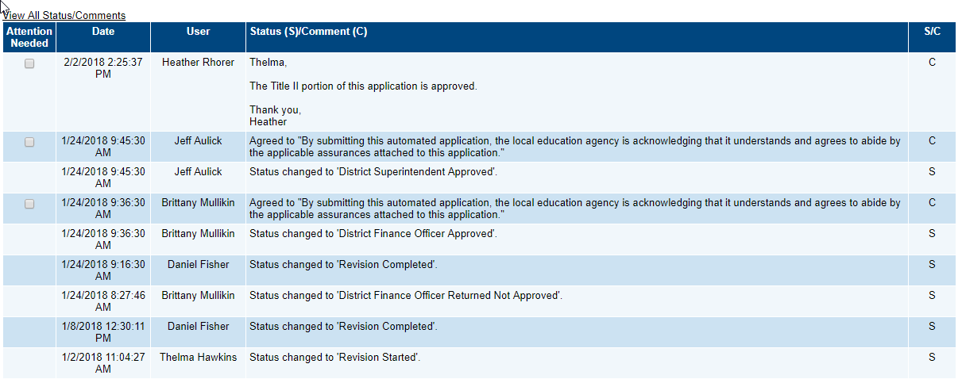
History Log
The History Log displays all status changes and Comments related to a funding application
Includes the User ID and timestamp for the change/comment

Slide 28
Comments
Comments are ongoing notes and discussion between SEA and the LEA related to a funding application
Comments can be made by anyone with access to the application at any time, regardless of status
Can be emailed to intended recipients
Comments are saved with the funding application Not visible to public users

Slide 29
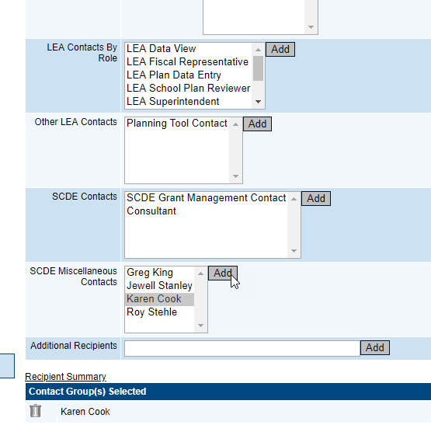
Emailing Comments

Slide 30
Change Log
Identifies all changes to a document occurring after a selected status change.
Allows LEA and SEA users to identify all changes that occur

Slide 31
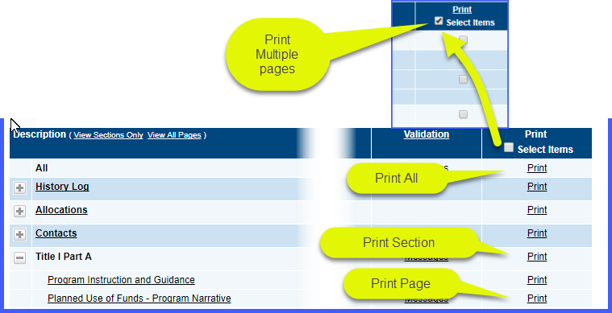
Printing
Print from Sections page
Print created as a PDF
Print Levels: All, single section, single page, or multiple individual pages
Click in Print checkbox to select multiple individual pages
Make sure pop-up blocker is turned off for NCCCIP

Slide 32
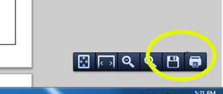
Printing
Small print jobs will be returned and displayed immediately
Larger print jobs (longer than 30 seconds to generate) will send an email when complete
Large print jobs will be available in SCDE Resources for the user
Print job displays as PDF
Print or download from PDF

Slide 33
Behavior Support Program Consultants
Can view all districts
Can use search for grants and funding applications
Consultants use comments on returned applications to communicate issues
System will create a report by grant and by district of all budget line items for use in assigning allotments

Slide 34
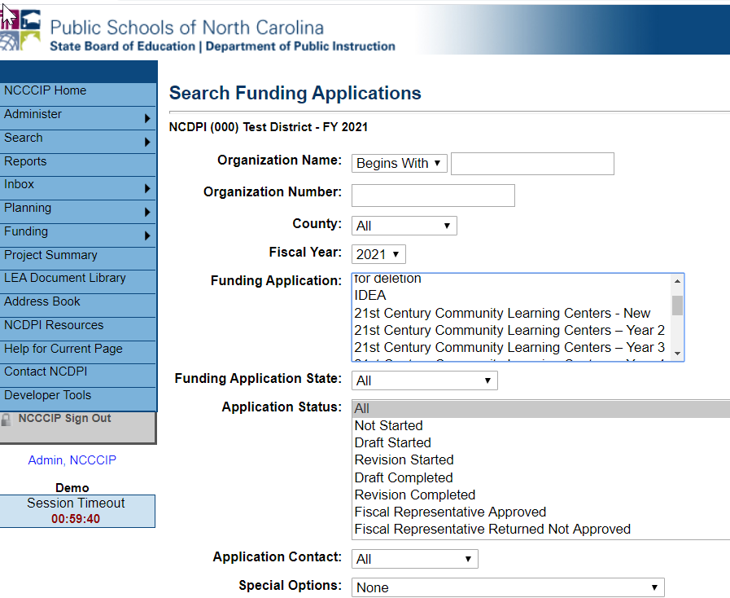
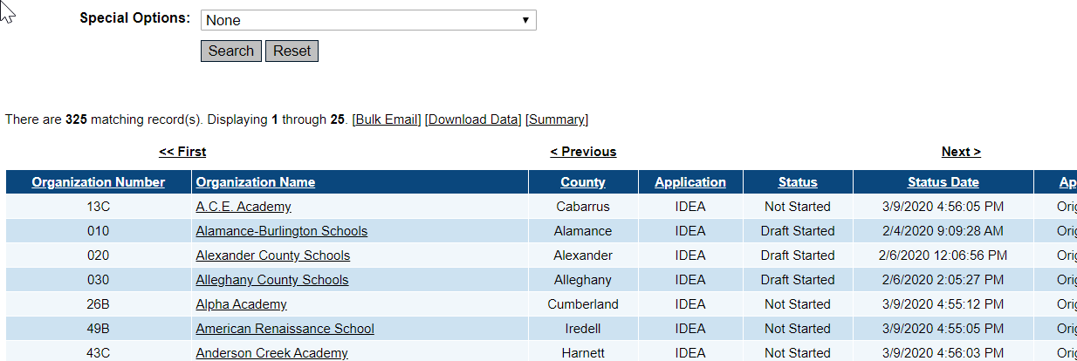
Search Screens
Search for Funding Applications, Grants, Plans, and District Documents from left navigation “Search” option
Limit search by using additional search options such as status, organization name, year

Slide 35
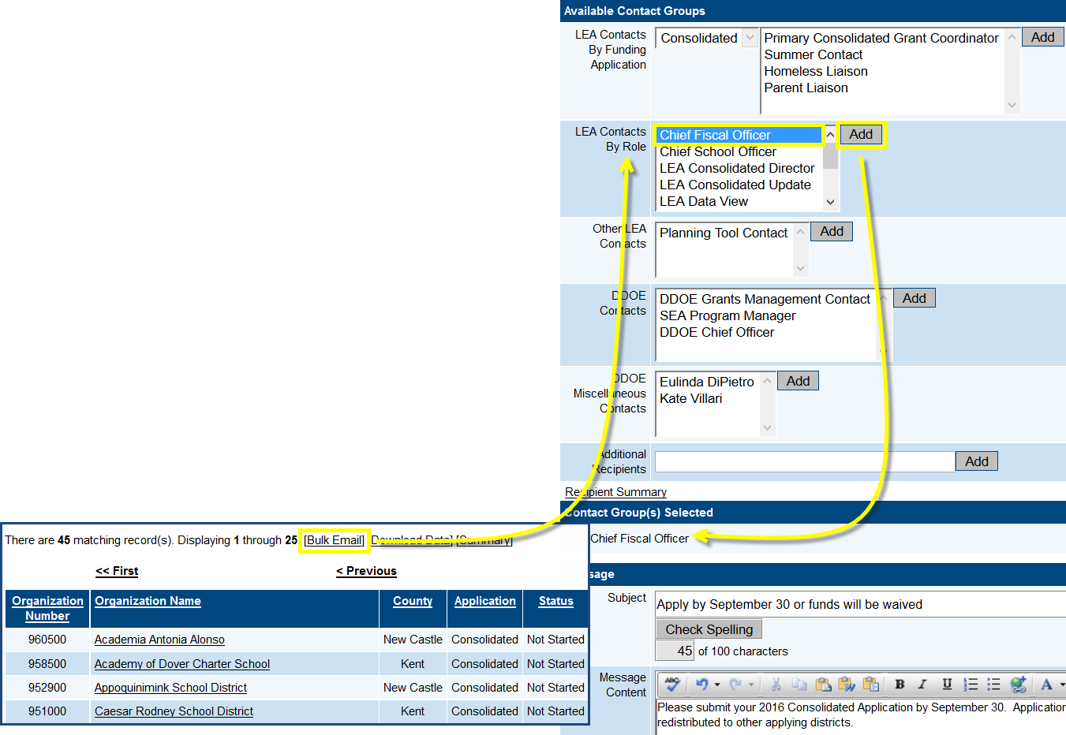
Bulk Email
Available from each Search Results screen
Allows quick communication to large number of targeted recipients

Slide 36
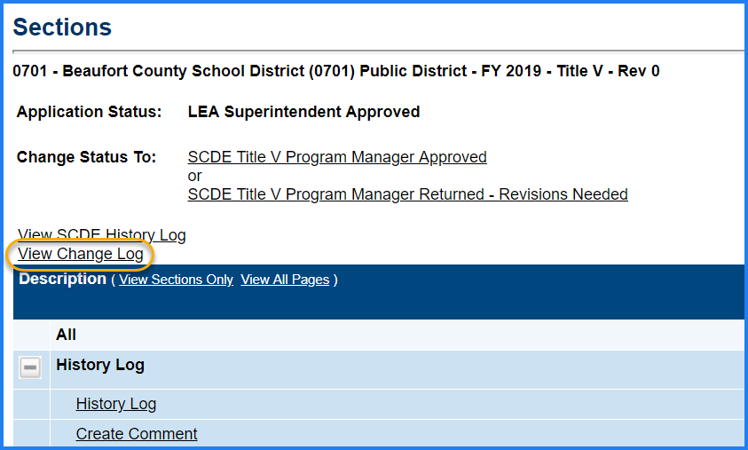
Change Log
All users have ability to view a list of changes that have been made to a funding application from a previous point in time
Very useful for reviewing a resubmission
Can tell what district changed from previous submission
Do not need to re-review entire application

Slide 37
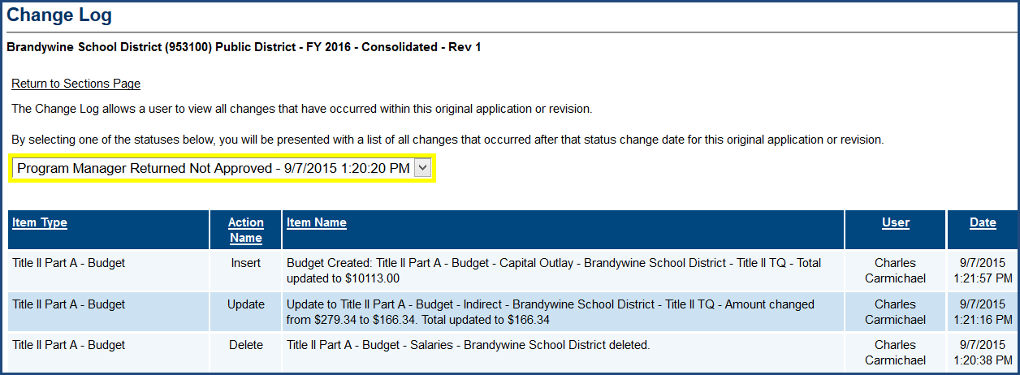
Change Log…continued
Drop down list gives user option of how far back to go in listing changes to the application

