Slide 1
Navigating CCIP: IDEA Grant

Slide 2
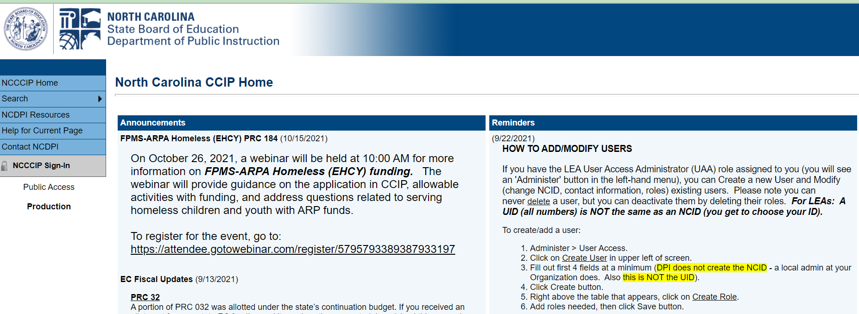
NC CCIP Main Page

Slide 3
Access and Logging In
Log in
https://ccip.schools.nc.gov
Using NCID (Not the PowerSchool ID)
Do NOT use the browser BACK button

Slide 4
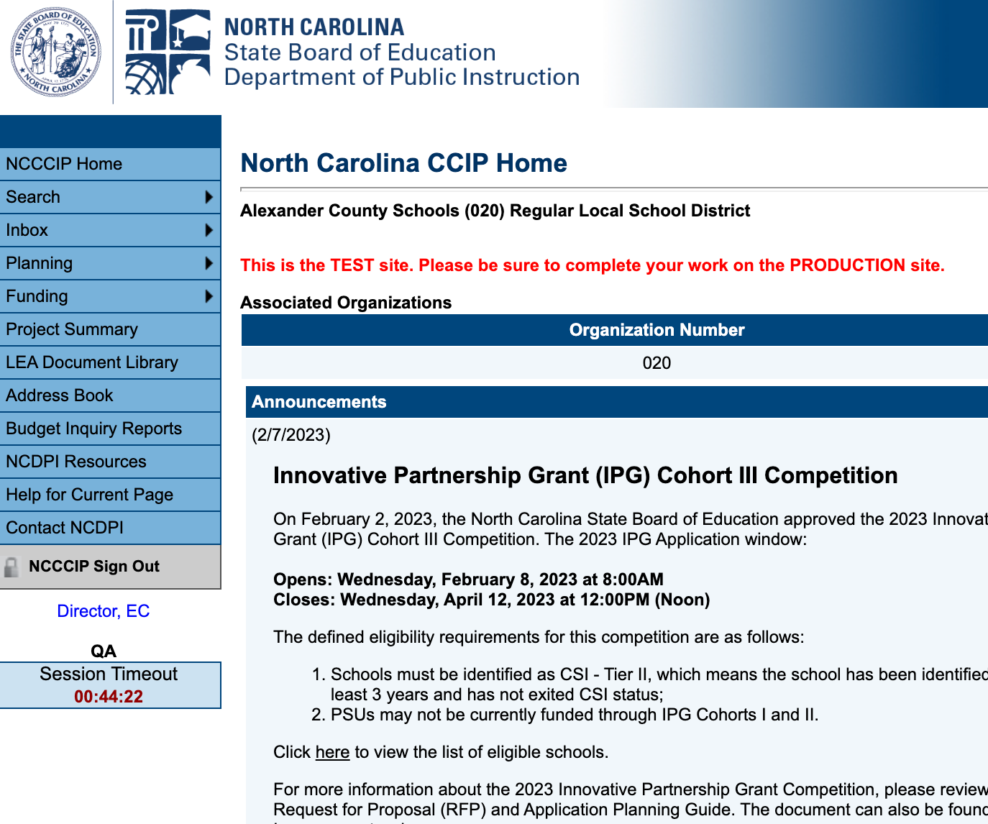
Main Page Information
In CCIP DO NOT use the back buttons on your browser.
CCIP has a built in Save feature that auto-saves when you navigate to a new page.
There is a 1 hour timer that will remind you to save when 10 mins are left.

Slide 5
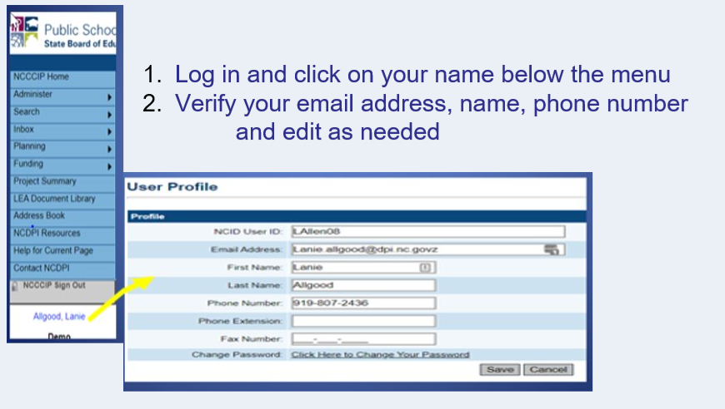
Verify Contact Information

Slide 6
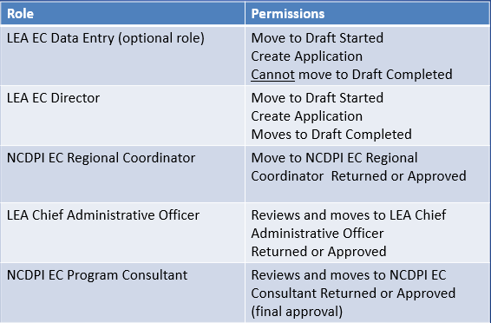
Roles in CCIP

Slide 7
Assigning Roles
Local User Access Administrator
Is the only one who can change or add users with the PSU.
NCDPI staff cannot add users to the PSU.
*Multiple uses can be in CCIP at the same time just not editing the same section.*

Slide 8
Getting Started with the 2023-2024 IDEA Grant
Click Funding and then Funding Applications
Change the year from 2023 to 2024
Click on IDEA

Slide 9
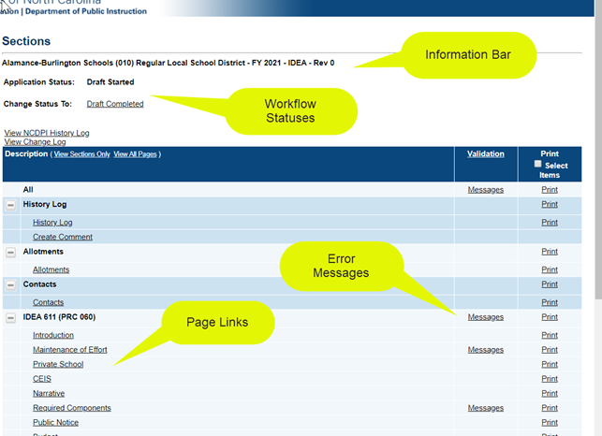
Sections Page
-All funding applications have a Sections page
-Functions - change statuses, links to grant pages, print, find errors, access Change Log
Notes:
9

Slide 10
Communicating in CCIP
From Sections page: Select Create Comment
Enter information
Select who the communication will go to.

Slide 12
Still have questions??
Contact your Regional Coordinator or Fiscal Monitor!!!

